Slide 1
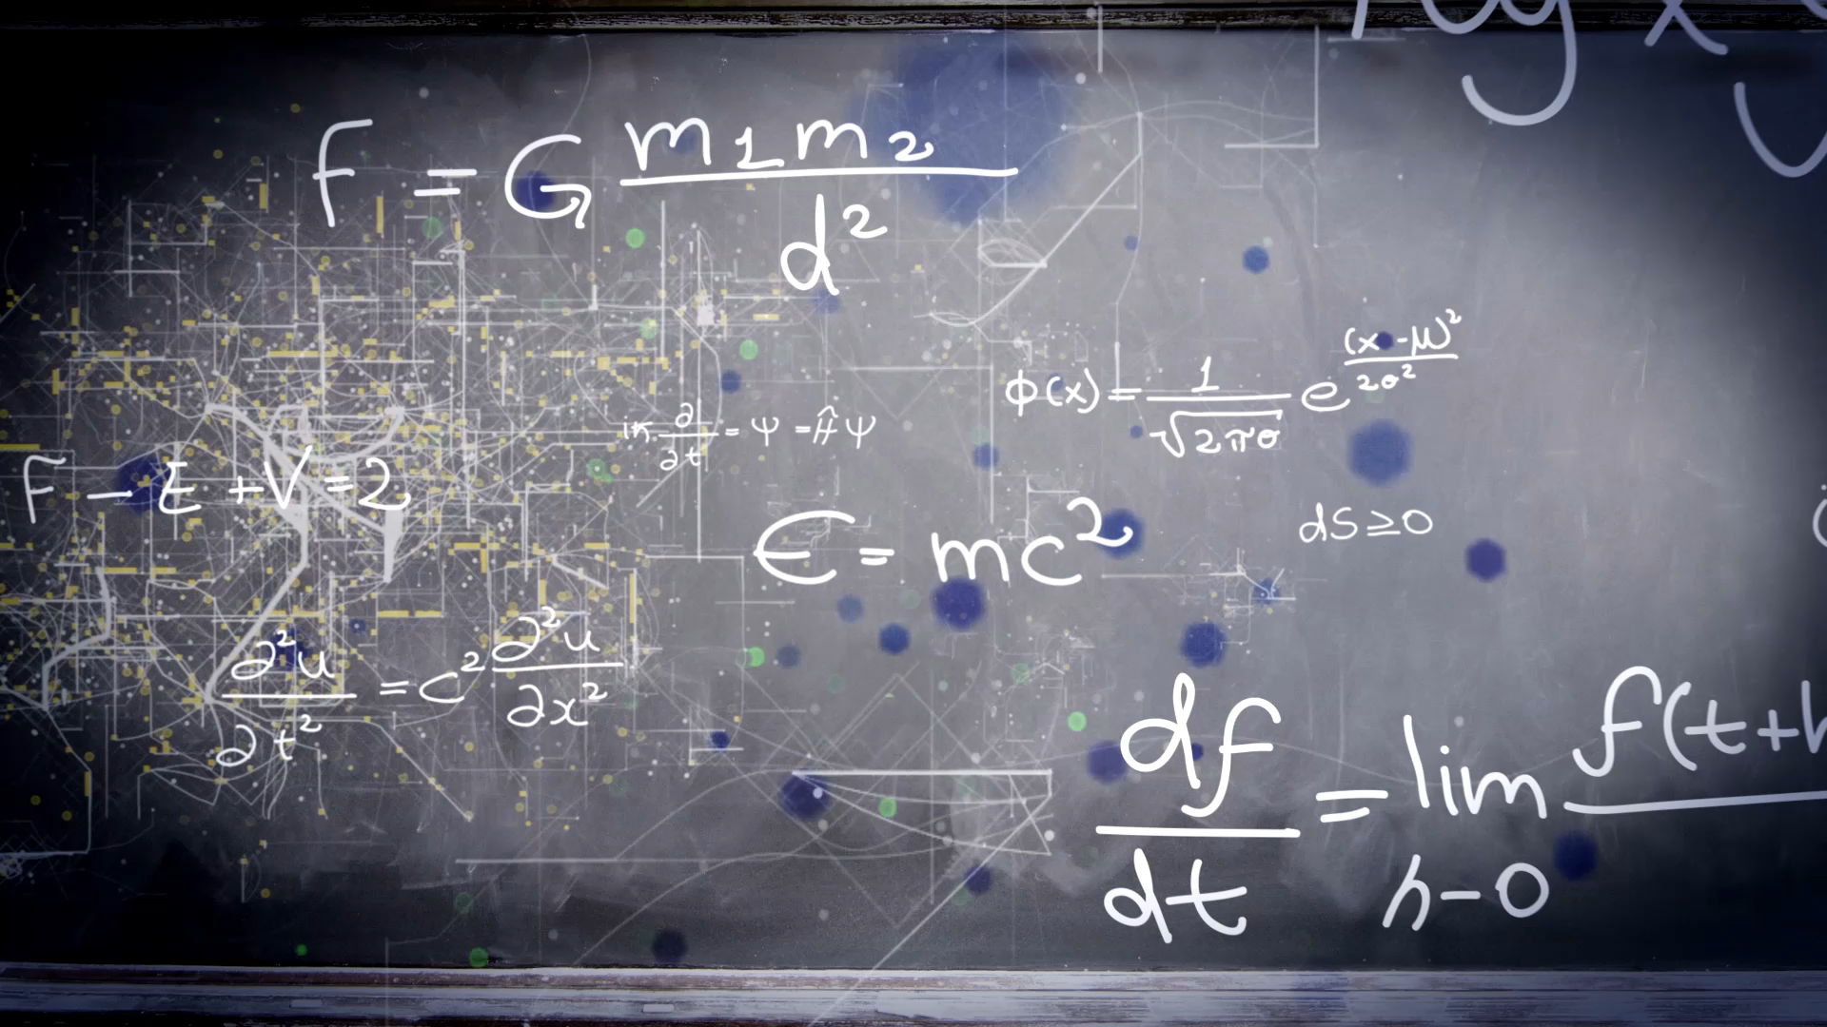
Complexity and Big O Notation
Introduction to Algorithm Analysis

Slide 2

What is Algorithm?
Algorithm is a finite sequence of well-defined, computer-implementable instructions, typically to solve a class of problems or to perform a computation.
Easily speaking, algorithm is a step-by-step procedure to solve a problem.

Slide 3
Examples of Algorithm in real life
How does Google Map find the shortest path?
How does YouTube know what videos you might want to watch, from 5 billion videos?
How does excel sheet sorts your financial statements in either descending order or ascending order?
How does Facebook/Instagram know what friends you should add?
More…

Slide 4

Is it important to compare algorithms?
If two different algorithms can accomplish the same task, then why do we care about which one is better?

Slide 5
Code example of adding numbers up to 100000000.

Slide 6

Time and Space are the concerns
We care about how much time it takes for an algorithm to finish a task. The less time it takes, the better it is.
Timing our code’s runtime is not realistic in terms of analysis. Why?
Same computer gets different runtime for the same task.
Different computing power machine gives different run time for the same task.
(we care about space as well, but not as much as time in this course.)

Slide 7

What is Complexity?
When analyzing the complexity of an algorithm, we calculate the (time or space) complexity.
Generally, every addition, subtraction, multiplication, division, comparison counts as one “operation.”
Complexity means given an input size, “how many operations do we need to perform in an algorithm?”
We use function f(n) to show the equation of complexity and input sizes.

Slide 8
Code example of console.log with loops.
Example.js
What is the f(n) of this function?
What is the graph?
What the mathematical relation? (quadratic)

Slide 9
Counting Operations Example 2
What is the f(n) of the first function? f(n) = 3
What is the mathematical relation? (Constant)
What is the f(n) of the second function? f(n) = n
What is the mathematical relation? (Linear)
What’s the data visualization?

Slide 10

Big O Notation
Big O Notation is a tool that describe the limiting behavior of a function when the argument tends towards a particular value or infinity.
Big O Notation has a “worst case scenario”, which means it shows the general trends of complexity when the size of inputs is extremely large.

Slide 11
Calculating Big O Value
Constant doesn't matter
Small Terms don't matter
Logarithm Base doesn’t matter

Slide 12
Example 1
Given an algorithm that has time complexity f(n) = 2n, what’s the big O of this algorithm?

Slide 13
Example 2
Given an algorithm that has time complexity f(n) = 13n^3 + 6n + 7, what’s the big O of this algorithm?

Slide 14

Example 3
Given an algorithm that has time complexity f(n) =$4\log_{2}{n}$, what’s the big O of this algorithm?

Slide 15
Example 4
Given an algorithm that has time complexity f(n) = 5, what’s the big O of this algorithm?

Slide 16
Common Big O of Algorithms
O(1)
O(logn)
O(n)
O(nlogn)
O(n^2)
O(n^3)

Slide 17
mathematical definition of Big O
And also big theta and big omega

Slide 18
Analysis of Arrays and Objects
Insertion, Removal, Searching, Access

